Slide 1



Teaching Intro and Advanced Graphics with WebGL
Patrick Cozzi
Analytical Graphics, Inc.
University of Pennsylvania
Ed Angel
University of New Mexico

Slide 2
Contents
Why WebGL?
From OpenGL to WebGL
Student Projects
Tools

Slide 3
What is WebGL
WebGL 1.0 is a JavaScript implementation of OpenGL ES 2.0
uses HTML5 Canvas element
runs in all recent browsers
OpenGL ES 2.0 is based on OpenGL 3.1
shader based
all fixed function pipeline functionality deprecated

Slide 4
Why WebGL
Runs across multiple devices including many smart phones
No system dependencies
Uses local resources
Integrates with other web applications

Slide 5
Why Teach with WebGL?
Broad deployment – web and mobile
Low barrier-to-entry
Fast Iteration
Tools
Performance
Modern-ish API
Notes:
Broad deployment
Great motivation for students
On all major browsers. Now in IE 11 and on by default in Safari in OS X Yosemite (this summer).
On mobile. Great support in Chrome on Android. Now in Safari on iOS 8 beta.
Low barrier-to-entry
Less code to create a first triangle than OpenGL + utility libraries.
Dev environment can be as simple as a text editor and browser. Many apps will require a simple webserver, e.g., for reading local textures. There are also online editors (later in this talk).
Fast Iteration
Just save and reload.
Tools
Browsers have great debuggers and profilers built-in.
There are several tools for WebGL debugging, profiling, and shader editing.
Performance
JavaScript performance is much better these days but still not nearly as fast as C++, however our graphics code runs on the GPU regardless of if it is WebGL or OpenGL so this is a useful point when teaching about how GPUs work.
Modern-ish API
WebGL is based on OpenGL ES 2.0, which is completely shader based. This is enough for teaching and intro course and even many advanced topics. WebGL 2 is based on ES 3.0 and will have many more modern features like instancing and uniform buffers. Many features are already available as extensions.
Related: “Why use WebGL for Graphics Research?” by Patrick Cozzi. 2014. http://www.realtimerendering.com/blog/why-use-webgl-for-graphics-research/

Slide 6
Why not WebGL?
Students need to learn JavaScript: not an issue
Academic integrity? not an issue
Not as sophisticated as recent versions of desktop OpenGL: not an issue for most classes
Startup time higher: minor issue
Speed: not an issue once data gets to GPU
Notes:
Students need to learn JavaScript
Web and JavaScript development require some ramp up. A graphics course is also good for getting C/C++ experience so using JavaScript means less C/C++.
Academic integrity? Not an issue
When deployed on the web, it is easy to view source. In Patrick’s course at Penn, we make each student’s project different, e.g., implement a ray tracer and select 3 of 5 effects. This also excites students and they often take the project further.
In Patrick’s course at Penn, we use WebGL whenever possible. We use OpenGL only when we need access to recent GPU features like compute and tessellation shaders.

Slide 7
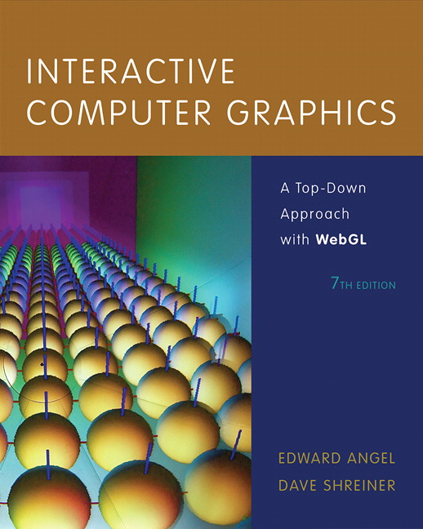
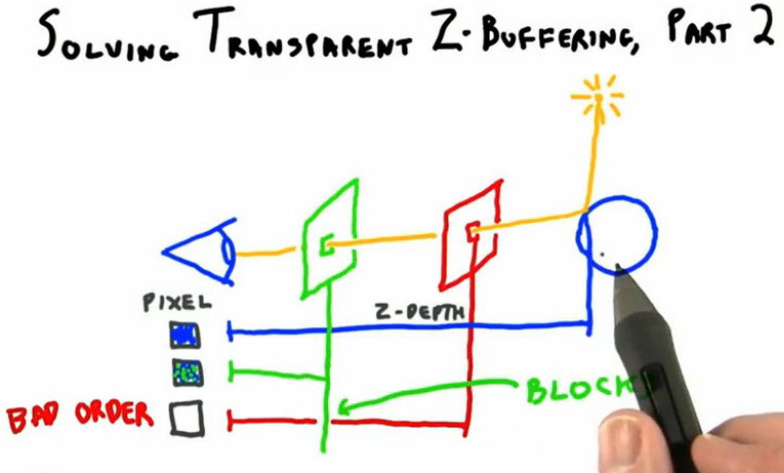
WebGL in Teaching
Interactive 3D Graphics Udacity course by Eric Haines
Intro class now in WebGL
Notes:
Interactive Computer Graphics with WebGL
Now in its 7th edition moved from core-profile OpenGL to WebGL.
There are also many other graphics book on WebGL like the “WebGL Programming Guide” by Kouichi Matsuda and Rodger Lea and “WebGL Beginner’s Guide” by Diego Cantor and Brandon Jones (example code: http://voxelent.com/resources/books-code-examples/).
Interactive 3D Graphics
By Eric Haines
Udacity course
~48K students
Course: https://www.udacity.com/course/cs291
Talk on teaching the course: http://cis565-fall-2013.github.io/lectures/11-04-Computer-Graphics-in-a-MOOC-Beyond-the-Hype-and-Hysteria.pptx
Introduction to WebGL Programming
SIGGRAPH course moved from OpenGL to WebGL in 2014
OpenGL course now online: https://www.youtube.com/watch?v=6-9XFm7XAT8
SIGGRAPH 2012 also had “Graphics Programming for the Web” course (slides: http://www.khronos.org/webgl/wiki/Presentations#SIGGRAPH_2012_Course_.22Graphics_Programming_for_the_Web.22)

Slide 8
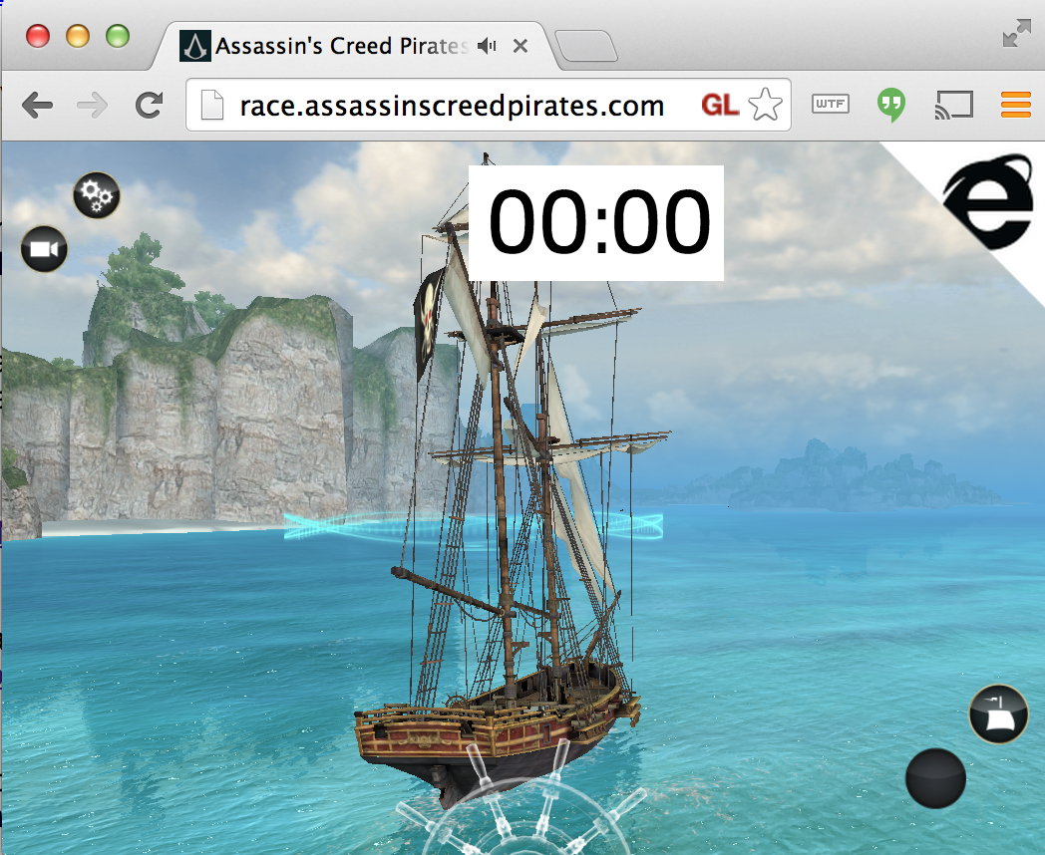
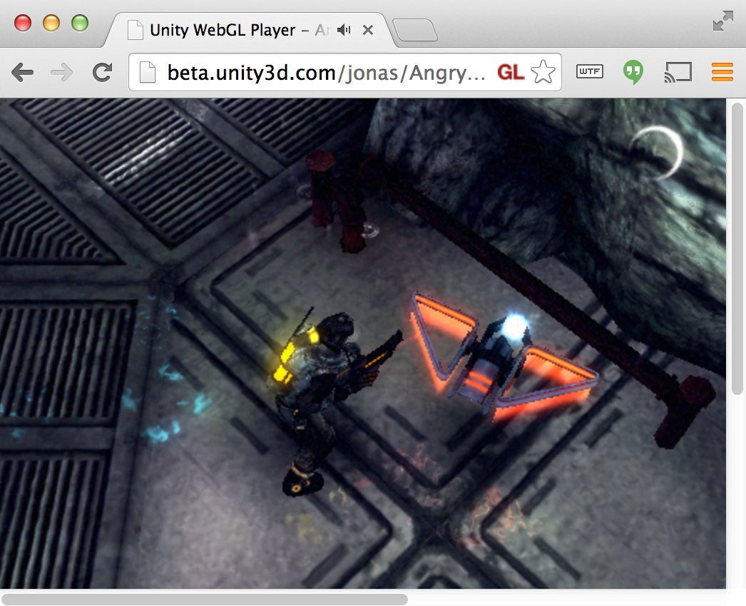
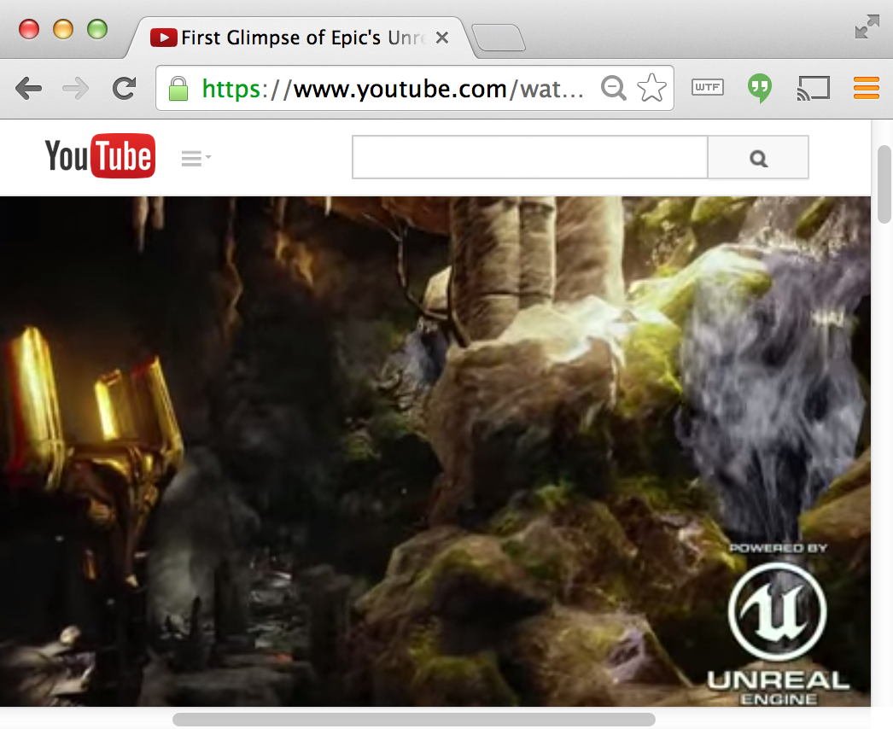
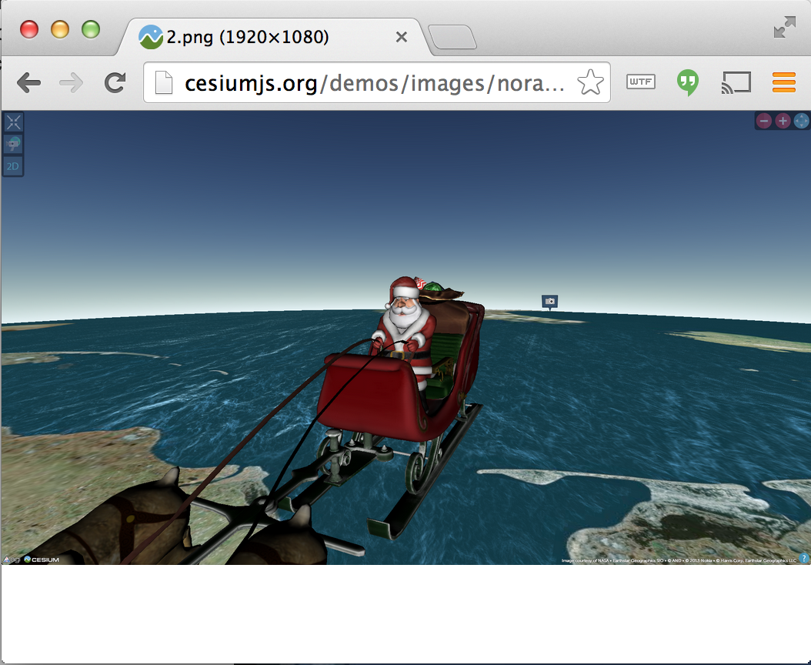

High-Profile WebGL Uses
Notes:
Assassin’s Creed – Microsoft + Ubisoft
IE 11 desktop and mobile
JavaScript using Babylon.JS
http://modern.ie/en-us/demos/assassinscreedpirates
Unity - Unity + Mozilla
Unity runtime. C/C++ -> emscripten -> JavaScript + asm.js
Game code. C# -> .NET bytecode -> C++ -> emscripten -> JavaScript + asm.js
http://blogs.unity3d.com/2014/04/29/on-the-future-of-web-publishing-in-unity/
http://blogs.unity3d.com/2014/05/20/the-future-of-scripting-in-unity/
Unreal Engine 4 – Epic + Mozilla
C++ -> emscripten -> JavaScript + asm.js
http://techcrunch.com/2014/03/12/epic-partners-with-mozilla-to-port-unreal-engine-4-to-the-web/
NORAD Tracks Santa - Analytical Graphics, Inc. + partners
JavaScript using Cesium
In 2013, 48.8% WebGL success across all browsers & platforms for 20M visitors, an increase of 146% over 2012.
http://cesiumjs.org/demos/noradtrackssanta.html
Google Maps – Google
Rewritten using WebGL
Vector data is no longer rasterizered, smooth zooms, 3D in beta
“Google Maps + WebGL = MapsGL” by Bill Baxter. 2012. https://docs.google.com/presentation/d/1pL-OZnsWIKWcXflfJV8MPH3kKBehn0Mlx6-cdjmP3A0/edit#slide=id.g1e3a90e_1_28
“Google MapsGL” by Bill Baxter and James Darpinian. 2012. https://docs.google.com/presentation/d/1zZgkOcQmpq2vHy9B6_2tF49ILKeasLqXrsrCn-Ni_vY/edit
More high-profile uses of WebGL
Sony built PS4 UI on WebGL - http://tonyparisi.wordpress.com/2014/01/14/the-tipping-point/
Disney - Find Your Way to OZ movie promo - http://www.findyourwaytooz.com/
Warner Brothers – Gravity movie promo - http://gravitymovie.warnerbros.com/#/home
New York Times – Hang glider visualization - http://www.nytimes.com/interactive/2013/01/13/sports/hang-gliding-record.html?_r=0
iOS RAGE WebGL demo (by Brandon Jones, not id)
https://www.youtube.com/watch?v=d0S2dsuSxHw
http://blog.tojicode.com/2011/05/rage-webgl-tech-talk.html
Quake 4 assets (using Turbulenz, not by id)
http://www.geek.com/games/turbulenz-webgl-engine-proves-quake-4-is-possible-in-a-browser-1505401/

Slide 9
Two Approaches
WebGL from the beginning
OpenGL then WebGL
fixed function OpenGL or shader-based OpenGL
Both approaches share some key elements that must be presented

Slide 10
Necessary New Elements
JavaScript
HTML
Execution in a browser
Interactivity

Slide 11
Starting with WebGL Ed’s course
Notes:
Also see:
“WebGL for OpenGL Developers” in OpenGL Insights by Patrick Cozzi and Scott Hunter. 2012. http://openglinsights.com/
“An Introduction to JavaScript for Sophisticated Programmers” by Morgan McGuire. 2014. http://casual-effects.blogspot.com/2014/01/an-introduction-to-javascript-for.html
“JavaScript: The Good Parts” by Douglas Crockford. 2008. http://shop.oreilly.com/product/9780596517748.do

Slide 12
Student projects from
CS 495/595 ECE 491/591: Special Topics (online)
CS/ECE 412: Computer Graphics

Slide 13
Syllabus
Week 1: Introduction and Overview
Week 2: Introduction to WebGL
Week 3: GLSL and Shaders
Week 4: Input and Interaction
Week 5: Geometry and Transformations
Week 6: Modeling and Viewing
Week 7: Projection Matrices and Shadows
Week 8: Lighting and Shading
Week 9: Buffers and Texture Mapping
Week 10: Discrete Techniques
Week 11: Off-Screen Rendering.
Week 12: Hierarchy
Week 13: Implementation
Week 14: Curves and Surfaces
Week 15: Global Rendering

Slide 14
Basic Decisions
Only JS and HTML
no JS or JQuery for required projects
discourage use of three.js
shaders in HTML file
Encourage use of separate HTML and JS files
HTML file for page layout, resources and shaders
JS file for WebGL

Slide 15

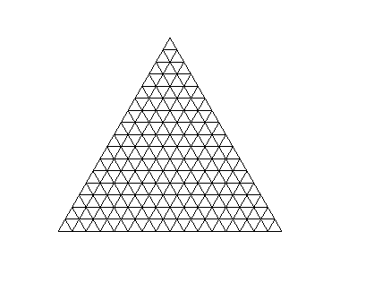


Project 1: Tessellation and Twist
triangle
tessellated triangle
twist without tessellation
twist after tessellation

Slide 16
Project 2: CAD
Stephen Harding

Slide 17
Project 3: 3D Maze

Slide 18
Term Project: CSG Modeler
Zach Friendland

Slide 19
Term Project: Animate Voronoi Diagram

Slide 20

From OpenGL to WebGL
Notes:
Also see:
“WebGL for OpenGL Developers” in OpenGL Insights by Patrick Cozzi and Scott Hunter. 2012. http://openglinsights.com/
“An Introduction to JavaScript for Sophisticated Programmers” by Morgan McGuire. 2014. http://casual-effects.blogspot.com/2014/01/an-introduction-to-javascript-for.html
“JavaScript: The Good Parts” by Douglas Crockford. 2008. http://shop.oreilly.com/product/9780596517748.do

Slide 21
TODO

Slide 22
Student Projects

Slide 23
TODO

Slide 24
Student projects from
CIS 565: GPU Programming and Architecture CIS 700/003: Real-Time Rendering
Notes:
All student work:
CIS 700
TODO
CIS 565
Fall 2013: http://cis565-fall-2013.github.io/studentwork.html
Fall 2012: http://cis565-fall-2012.github.io/studentwork.html
Spring 2012: http://cis565-spring-2012.github.io/studentwork.html
Spring 2011: http://www.seas.upenn.edu/~cis565/StudentWork-2011S.htm

Slide 25
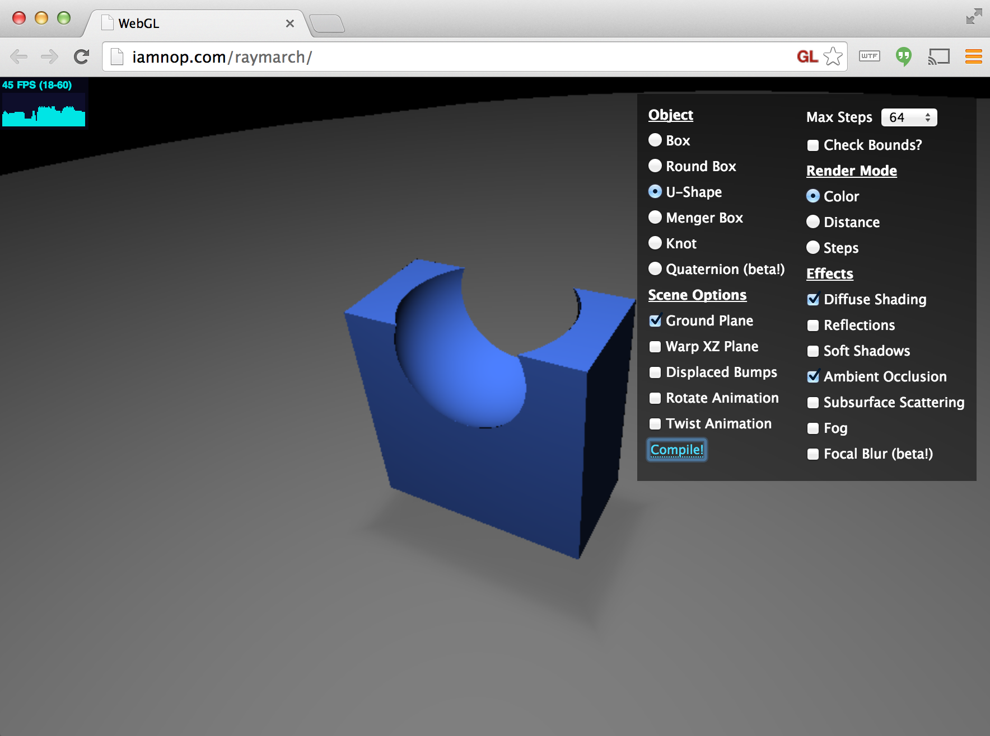
Ray Marching Distance Fields
Nop Jiarathanakul – CIS 565 Spring 2012
Notes:
Demo: http://iamnop.com/raymarch/
Blog: http://nopjia.blogspot.com/2012/04/final-deliverables.html
Nop is now a graphics engineer at Storm8.

Slide 26
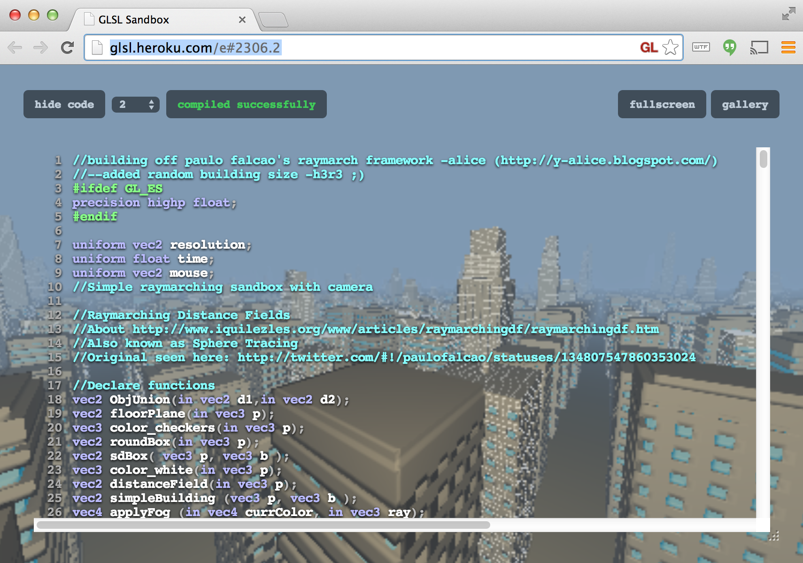
Procedural Infinite City
Alice Yang – CIS 565 Spring 2012
Notes:
Demo: http://glsl.heroku.com/e#2306.2
Blog: http://y-alice.blogspot.com/2012/04/final-submission.html
Alice is now a masters student at University of Pennsylvania.

Slide 27
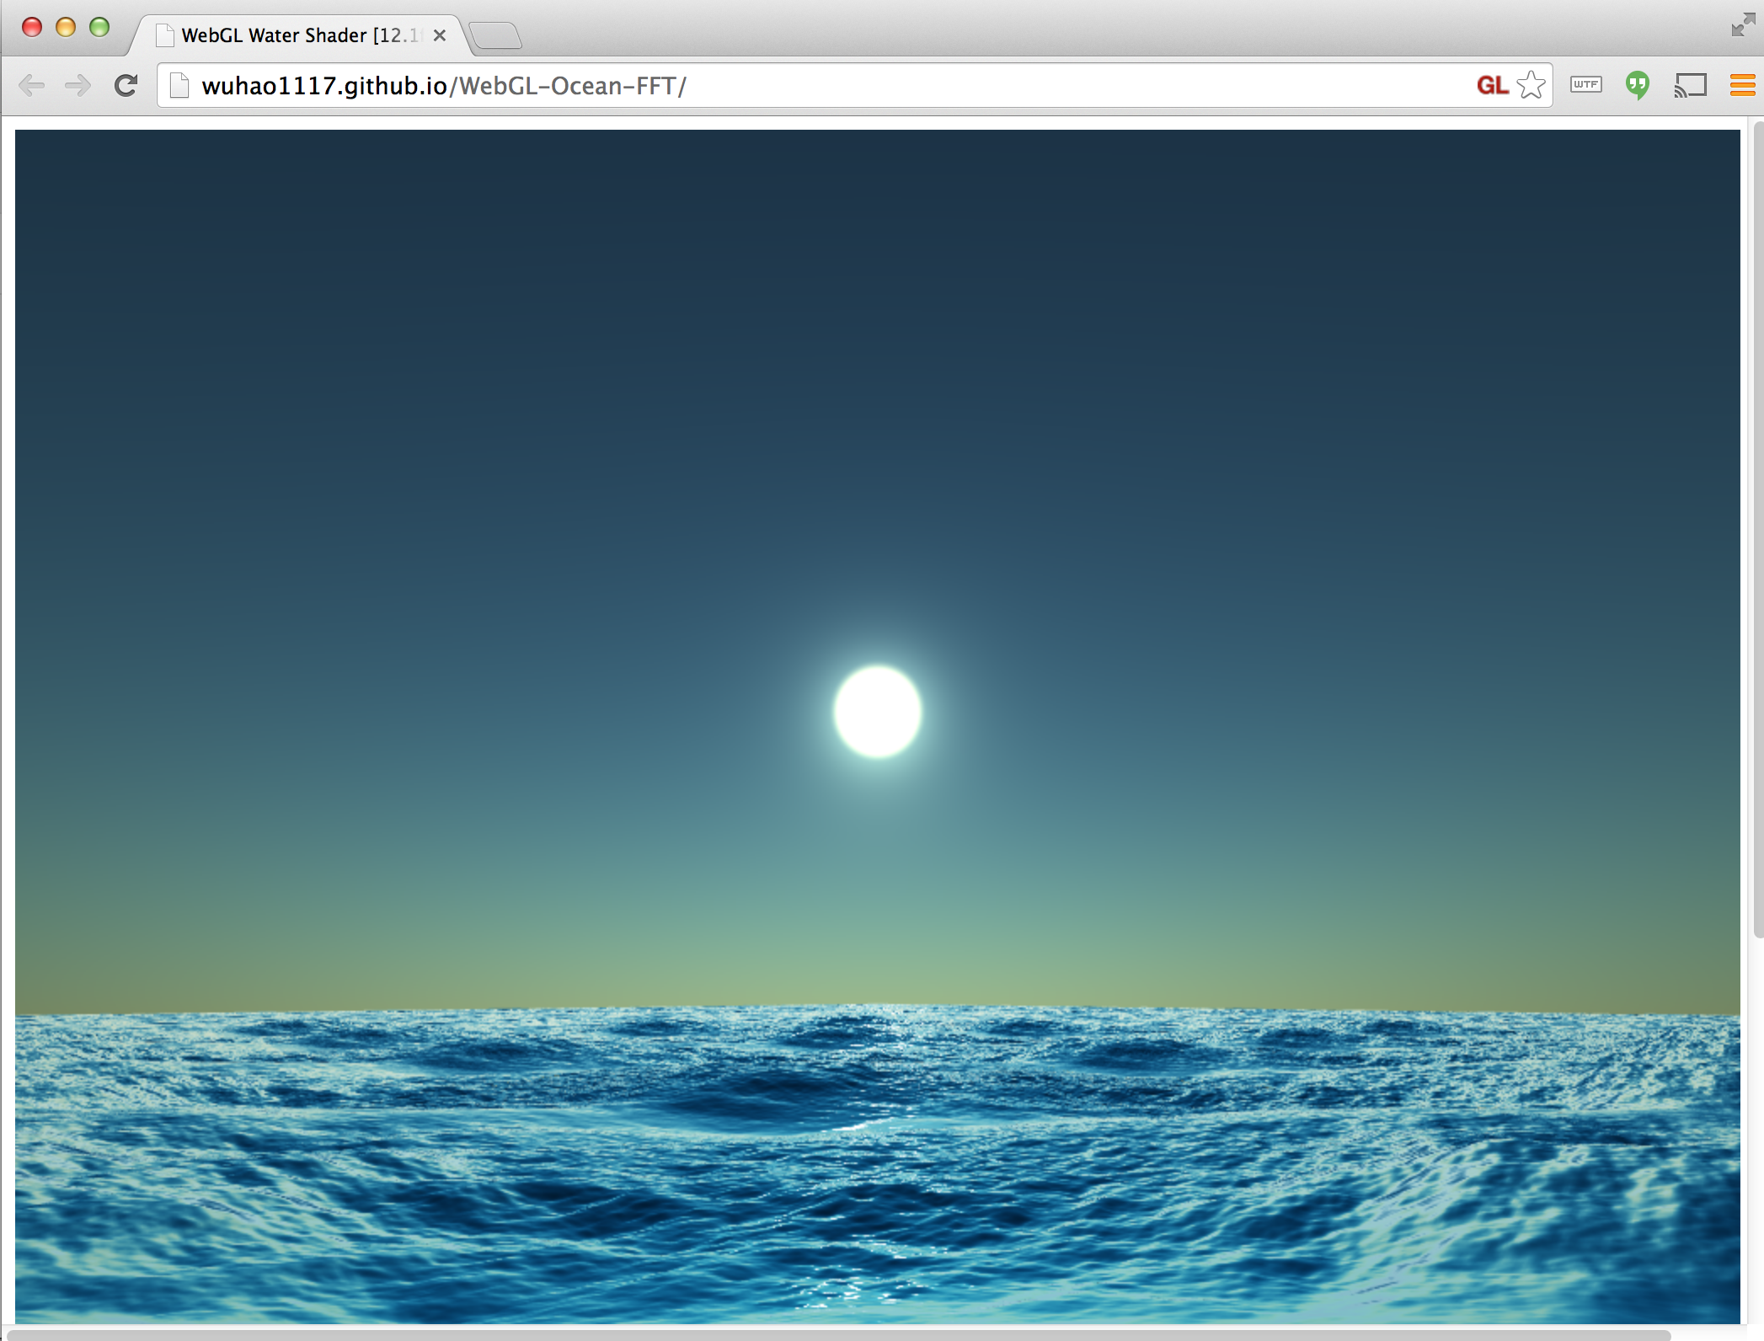
Water
Hao Wu and Guanyu He – CIS 565 Fall 2013
Notes:
Demo: http://wuhao1117.github.io/WebGL-Ocean-FFT/
Info: http://www.wuhao.co/webgl-fft-ocean.html
Hao is now a developer at Sony (TODO: verify). Guanyu is a Front End Engineer at Drawbridge, Inc.

Slide 28
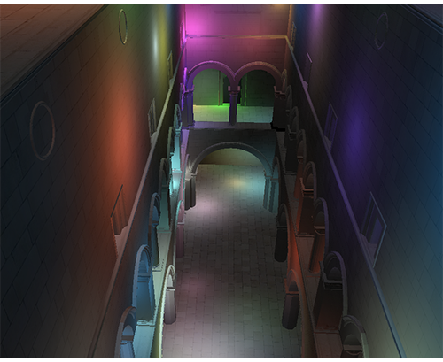
Deferred Shading
Sijie Tian and Yuqin Shao – CIS 565 Fall 2013
Notes:
Demo: http://sijietian.com/WebGL/deferredshading/index.html
Article: https://hacks.mozilla.org/2014/01/webgl-deferred-shading/
Sijie is now TODO. Yuqin is now TODO.

Slide 29
Particle Fluid Simulation
TODO
Alex Miller and Noah Lyons – CIS 700/003 Spring 2014
Notes:
Sec3 engine: http://www.noahbenjaminlyons.com/sec3/
Demo: http://alexmiller12.github.io/WebGL-Fluids/
Slides: Any update here? I'd love to be able to link to any of your articles, slides, videos, demos in my SIGGRAPH talk which I've started working on now.
Thanks,
Patrick

Slide 30
Tools

Slide 31
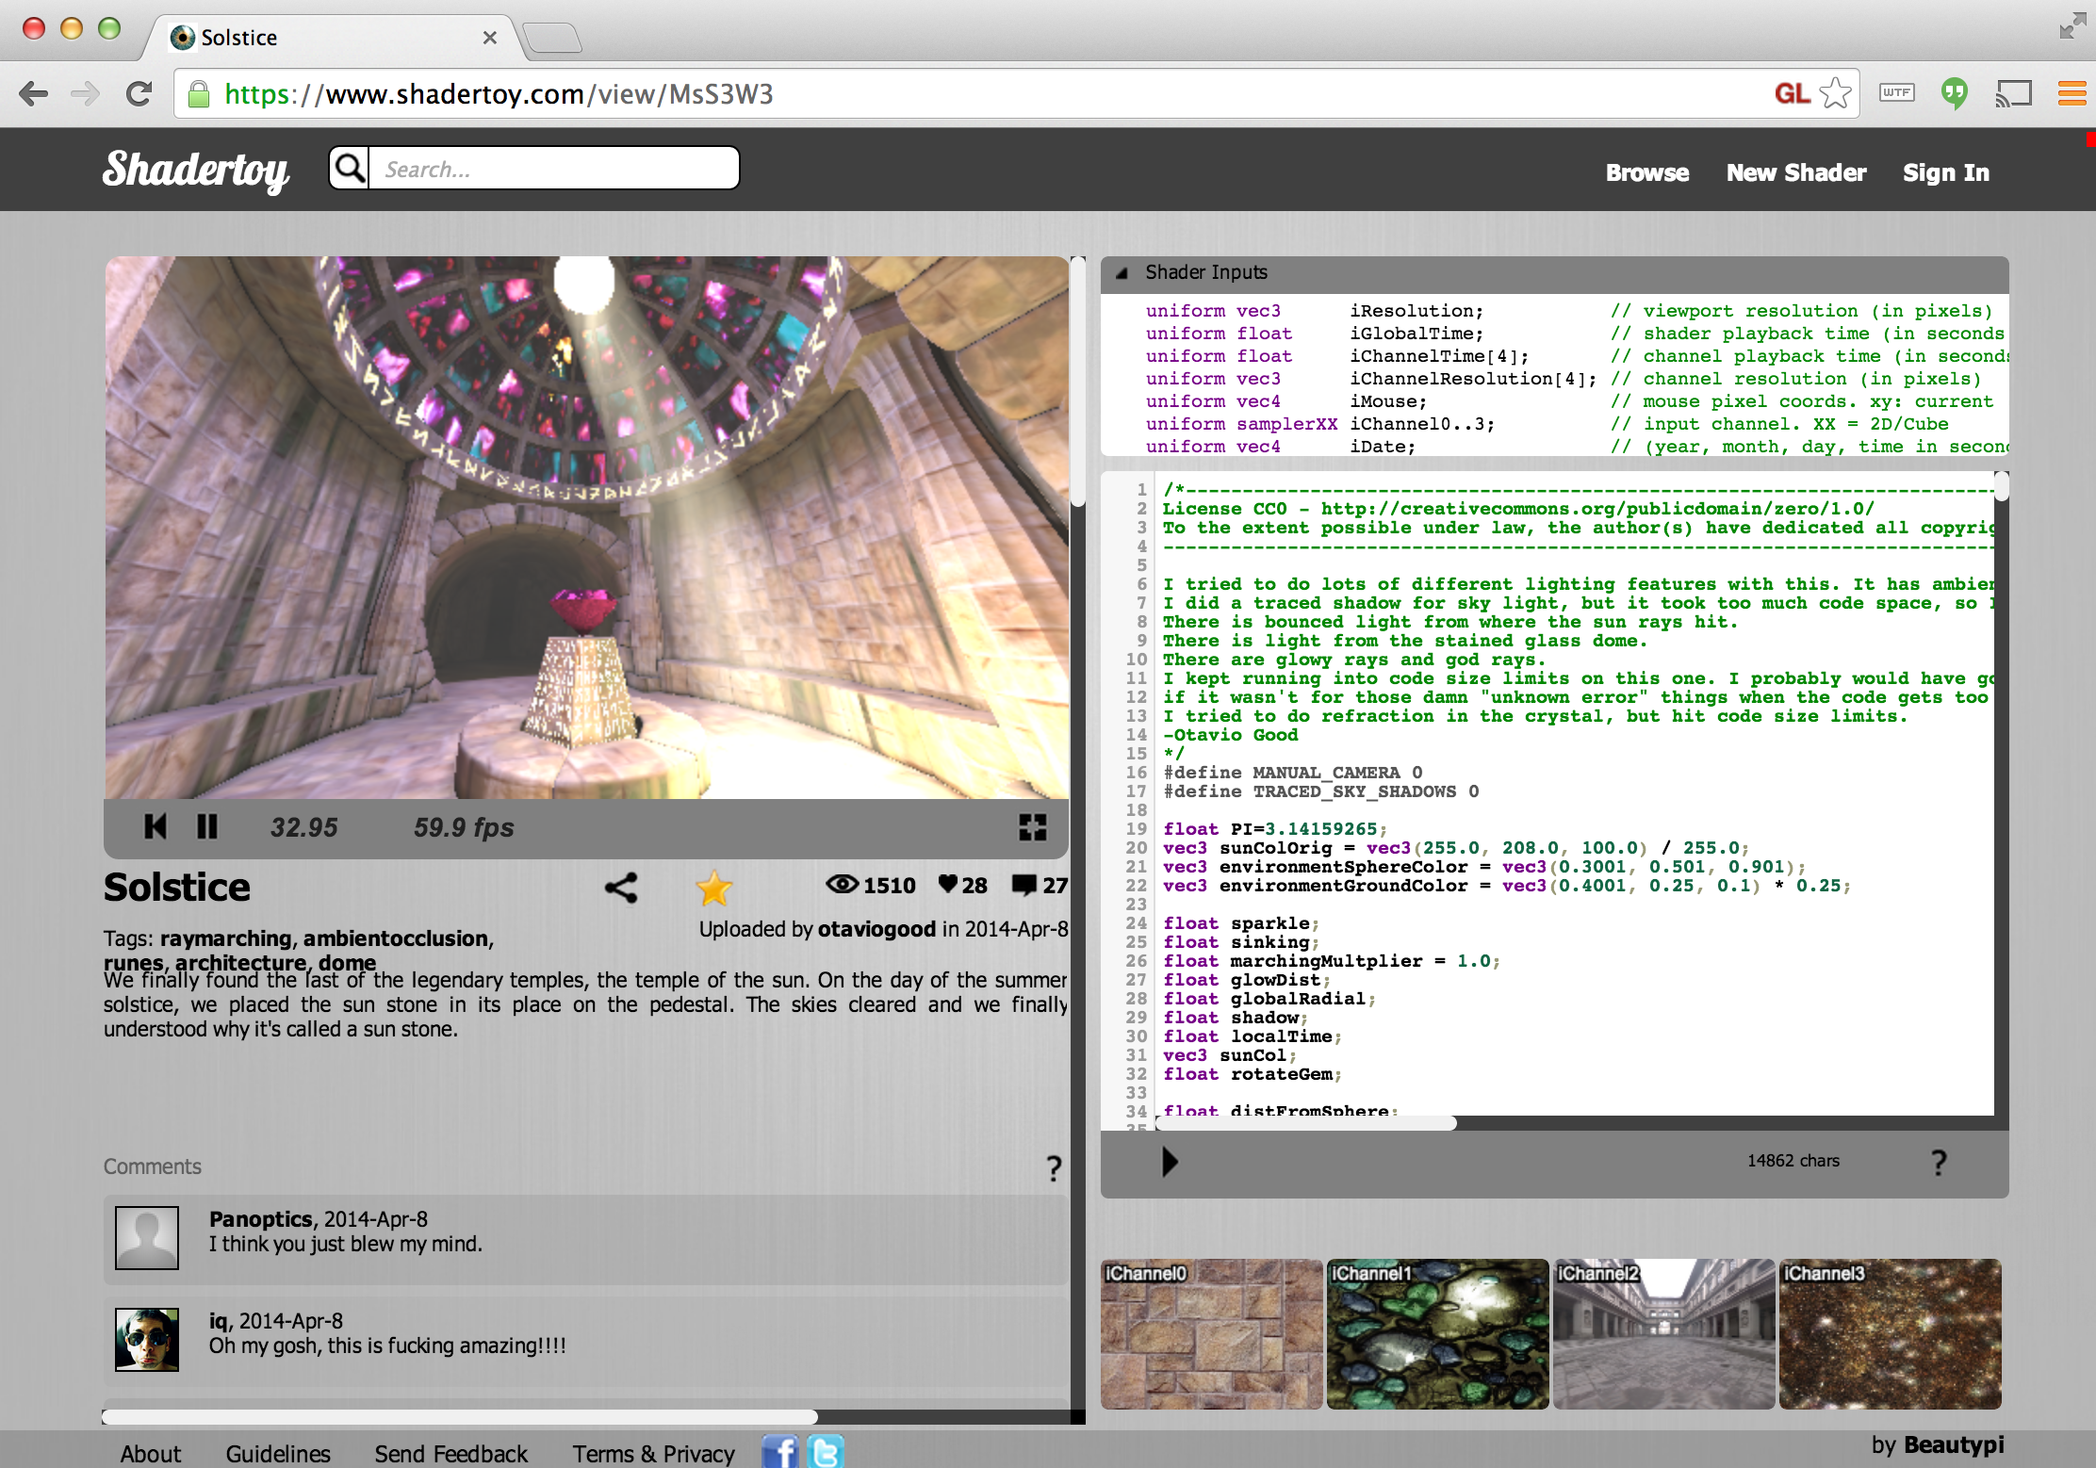
Online Shader Editors
Notes:
Shadertoy
https://www.shadertoy.com
Great for class hackathons
“Hackathons in the classroom” by Patrick Cozzi. 2012. http://blog.virtualglobebook.com/2012/12/hackathons-in-classroom.html
Great for ray marching distance functions
“Rendering Worlds with Two Triangles with raytracing on the GPU in 4096 bytes” by Iñigo Quilez. 2008. http://www.iquilezles.org/www/material/nvscene2008/rwwtt.pdf
Slides 23-29 in particular
“Modeling with distance functions” by Iñigo Quilez. 2008. http://iquilezles.org/www/articles/distfunctions/distfunctions.htm
GLSL Sandbox
http://glsl.heroku.com/
Older than Shadertoy but allows reading the previous frame’s backbuffer, for example, for implementing cellular automata.

Slide 32
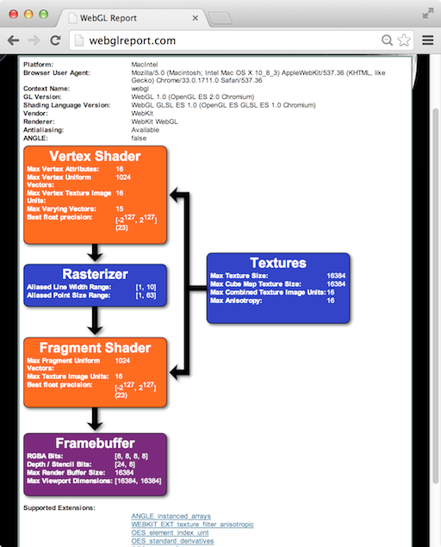
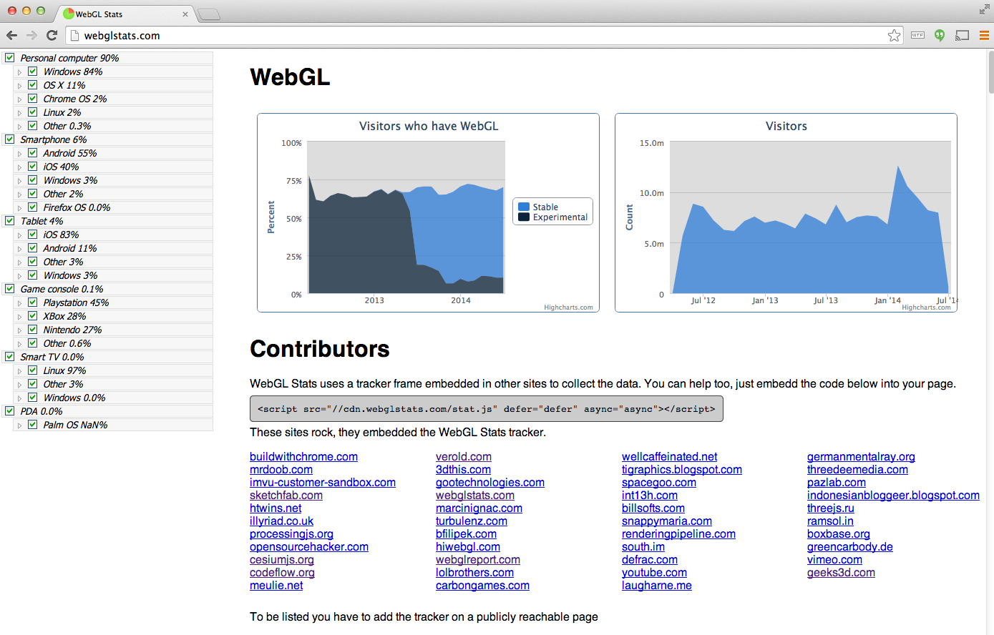
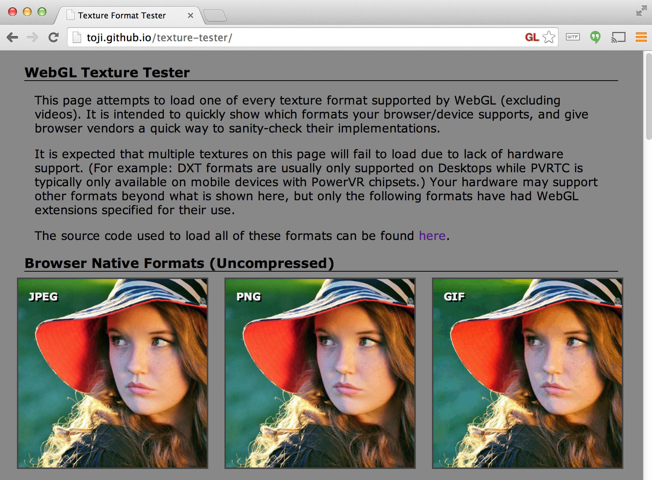
System Capability Tools
Notes:
WebGL Report
See system-dependent values and extensions
App: http://webglreport.com/
WebGL Stats
App: http://webglstats.com/
Info: http://codeflow.org/entries/2014/feb/04/webgl-stats-version-2/
WebGL Texture Tester
See what texture formats a system supports
App: http://toji.github.io/texture-tester/
See “WebGL Debugging and Profiling Tools” by Patrick Cozzi. 2013. http://www.realtimerendering.com/blog/webgl-debugging-and-profiling-tools/

Slide 33
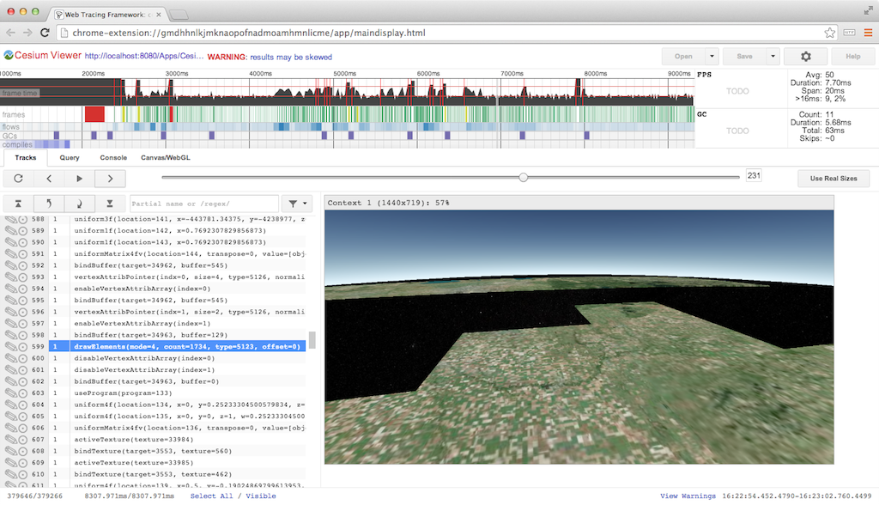
Web Tracing Framework
Notes:
Web Tracing Framework (WTF)
http://google.github.io/tracing-framework/
By Google
Similar to Canvas debuggers plus see the timing of each frame in detail
Show common CPU bottlenecks
GC (browser)
Shader compile/link (driver)
Texture/buffer upload (driver)
readPixels (stall)
WebGL Inspector
http://benvanik.github.io/WebGL-Inspector/
Older tool similar to Canvas debuggers and WTF

Slide 34
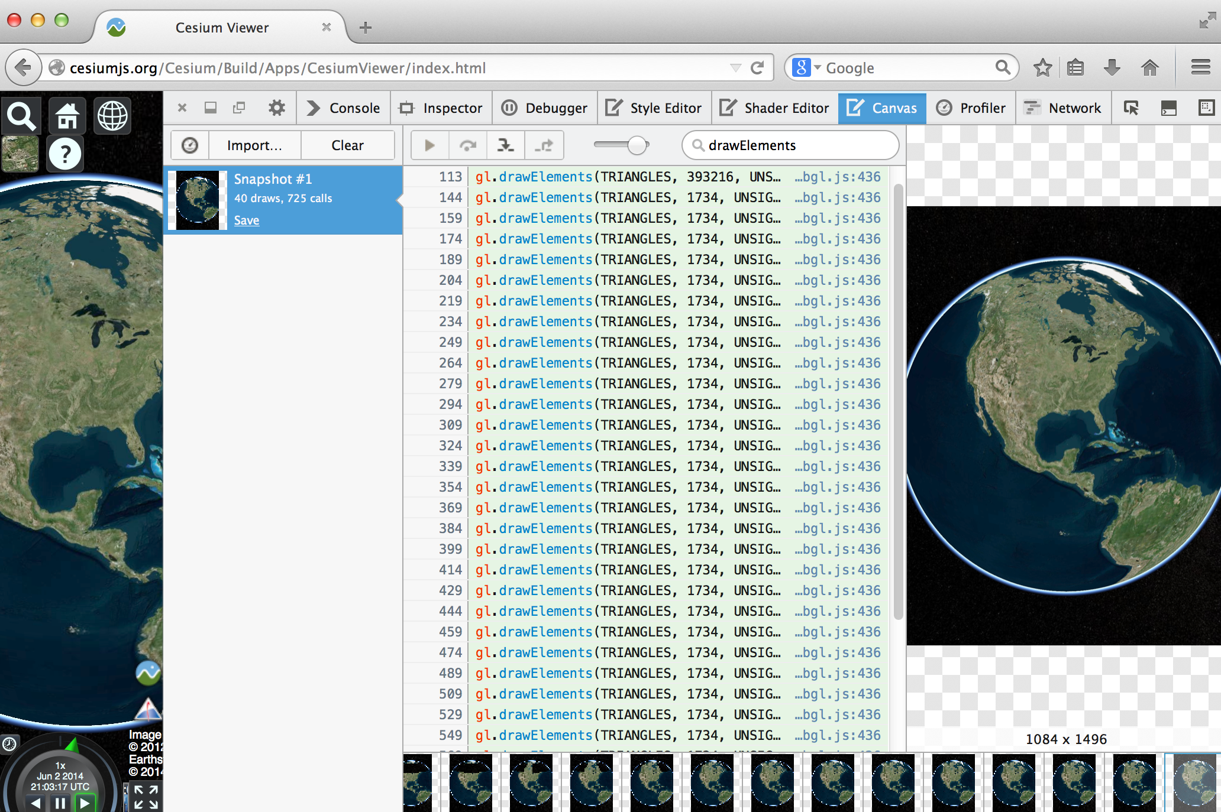
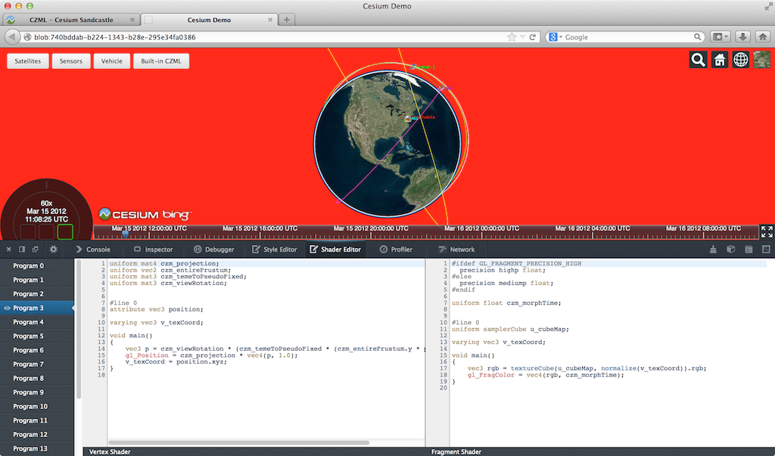
WebGL Tools - Firefox
Notes:
WebGL Shader Editor
See all loaded shaders
See what part of the scene is affected by a shader
Tweak shaders on the fly
Article: https://hacks.mozilla.org/2013/11/live-editing-webgl-shaders-with-firefox-developer-tools/
Canvas Debugger
Step through a frame. Filter calls. See the scene build draw call by draw call.
Article: https://hacks.mozilla.org/2014/03/introducing-the-canvas-debugger-in-firefox-developer-tools/

Slide 35
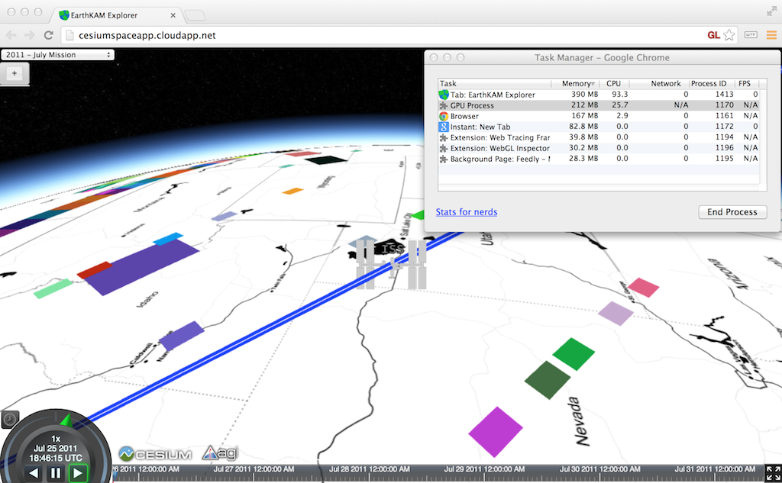
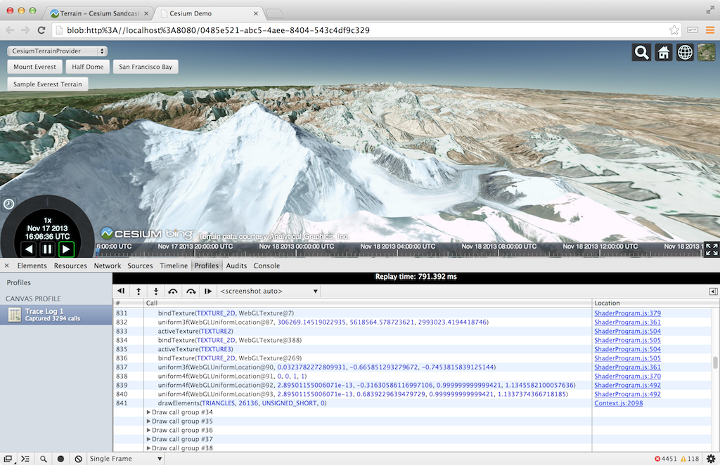
WebGL Tools - Chrome
Notes:
Canvas Inspector
Similar to Firefox Canvas Debugger. Integrates nicely with Chrome debugger
Article: http://www.html5rocks.com/en/tutorials/canvas/inspection/
Chrome Task Manager
Useful for quick and dirty memory usage
in the Window menu

Slide 36
Contact Info
Patrick Cozzi
Analytical Graphics, Inc.
University of Pennsylvania
@pjcozzi
pjcozzi@siggraph.org
www.seas.upenn.edu/~pcozzi/
Ed Angel
University of New Mexico
angel@cs.unm.edu
www.cs.unm.edu/~angel/

